Slide 1
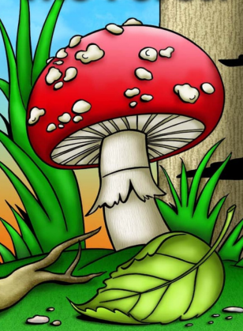
The Forest

Slide 2
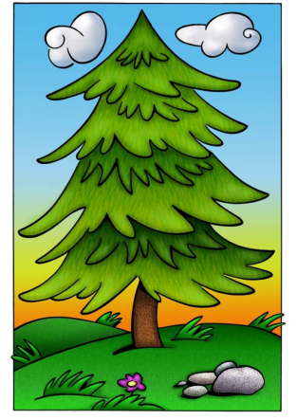
This is a tree.

Slide 3
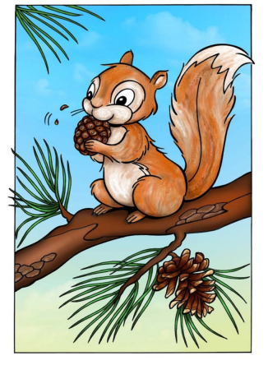
This is a squirrel.

Slide 4
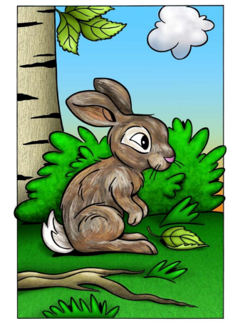
This is a rabbit.

Slide 5
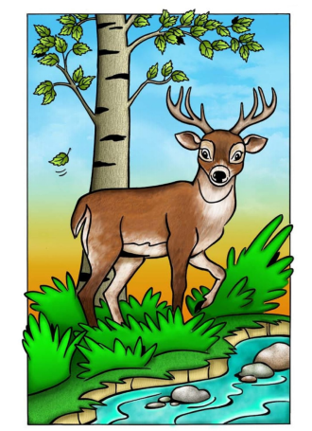
This is a deer.

Slide 6
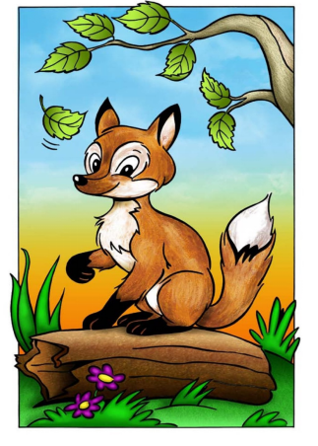
This is a fox.

Slide 7
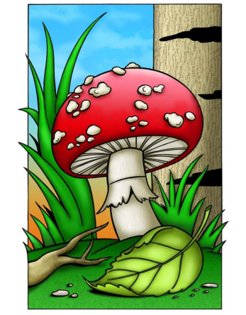
This is a mushroom.

Slide 8
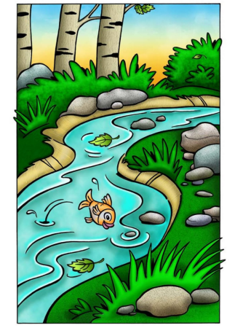
This is a stream.

Slide 9
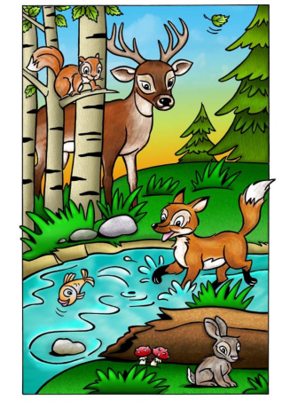
This is a forest.

Slide 10
Tree
Squirrel
Rabbit
Click on the colored stars to start getting to know them!
Deer
Fox
Mushroom
Stream
Forest

Slide 11
This is a tree.
RETURN

Slide 12
RETURN
This is a squirrel.

Slide 13
RETURN
This is a rabbit.

Slide 14
RETURN
This is a deer.

Slide 15
RETURN
This is a fox.

Slide 16
RETURN
This is a mushroom.

Slide 17
RETURN
This is a stream.

Slide 18
RETURN
This is a forest.

